Slide 1
Chapter 3
Data Modeling Using the Entity-Relationship (ER) Model

Slide 2
Chapter 3 Outline
Using High-Level Conceptual Data Models for Database Design
A Sample Database Application
Entity Types, Entity Sets, Attributes, and Keys
Relationship Types, Relationship Sets, Roles, and Structural Constraints
Weak Entity Types

Slide 3
Chapter 3 Outline (cont’d.)
Refining the ER Design for the COMPANY Database
ER Diagrams, Naming Conventions, and Design Issues
Example of Other Notation: UML Class Diagrams
Relationship Types of Degree Higher than Two

Slide 4
Data Modeling Using the
Entity-Relationship (ER) Model
Entity-Relationship (ER) model
  Popular high-level conceptual data model
ER diagrams
  Diagrammatic notation associated with the ER model
Unified Modeling Language (UML)

Slide 5
Using High-Level Conceptual Data Models for Database Design
Requirements collection and analysis
  Database designers interview prospective database users to understand and document data requirements
  Result: data requirements
  Functional requirements of the application

Slide 6
Using High-Level Conceptual Data Models (cont’d.)
Conceptual schema
  Conceptual design
  Description of data requirements
  Includes detailed descriptions of the entity types, relationships, and constraints
  Transformed from high-level data model into implementation data model

Slide 7
Using High-Level Conceptual Data Models (cont’d.)
Logical design or data model mapping
  Result is a database schema in implementation data model of DBMS
Physical design phase
  Internal storage structures, file organizations, indexes, access paths, and physical design parameters for the database files specified

Slide 8
A Sample Database Application
COMPANY
  Employees, departments, and projects
  Company is organized into departments
  Department controls a number of projects
  Employee: store each employee’s name, Social Security number, address, salary, sex (gender), and birth date
  Keep track of the dependents of each employee

Slide 9
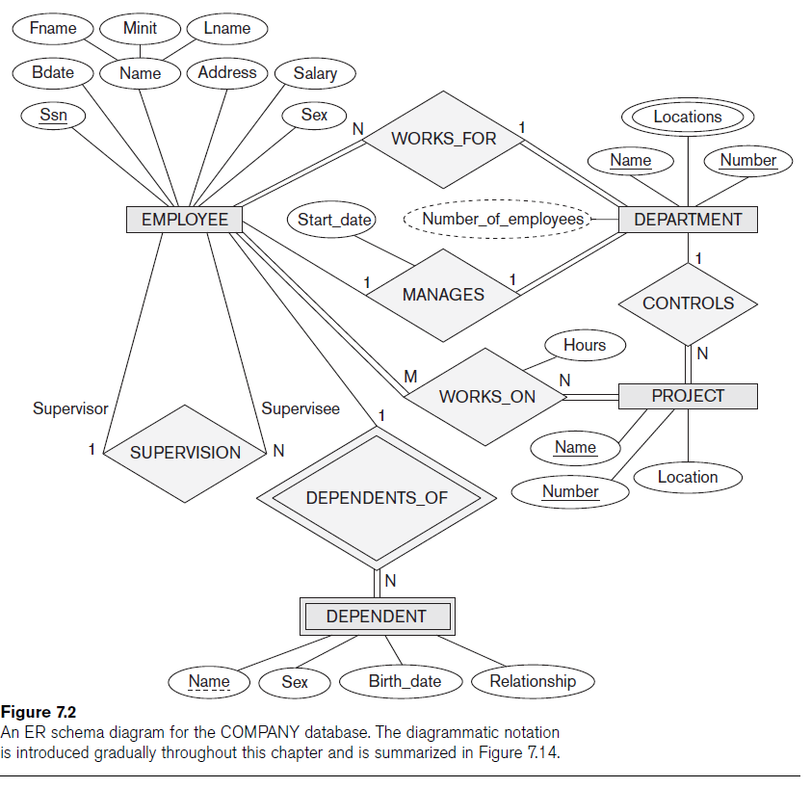

Slide 10
Entity Types, Entity Sets, Attributes, and Keys
ER model describes data as:
  Entities
  Relationships
  Attributes

Slide 11
Entities and Attributes
Entity
  Thing in real world with independent existence
Attributes
  Particular properties that describe entity
  Types of attributes:
    Composite versus simple (atomic) attributes
    Single-valued versus multivalued attributes
    Stored versus derived attributes
    NULL values
    Complex attributes

Slide 12
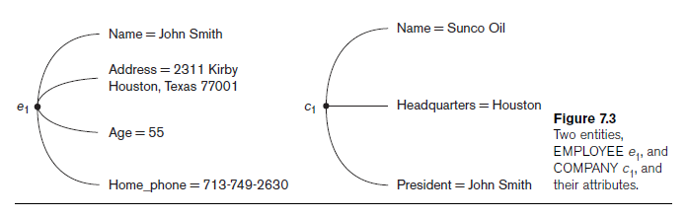
Entities and Attributes (cont’d.)

Slide 13
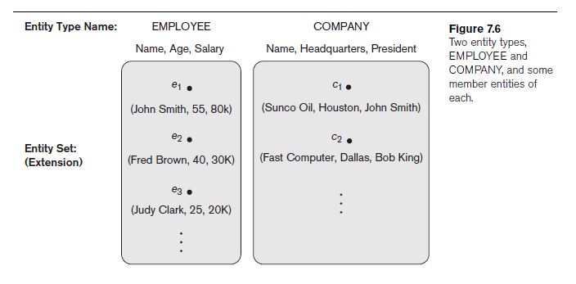
Entity Types, Entity Sets, Keys, and Value Sets
Entity type
  Collection (or set) of entities that have the same attributes

Slide 14
Entity Types, Entity Sets, Keys, and Value Sets (cont’d.)
Key or uniqueness constraint
  Attributes whose values are distinct for each individual entity in entity set
  Key attribute
    Uniqueness property must hold for every entity set of the entity type
Value sets (or domain of values)
  Specifies set of values that may be assigned to that attribute for each individual entity

Slide 15
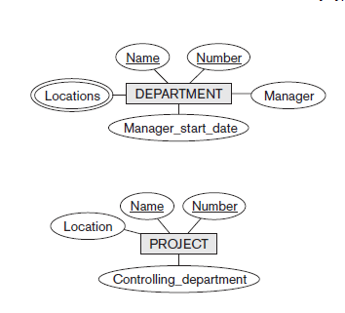
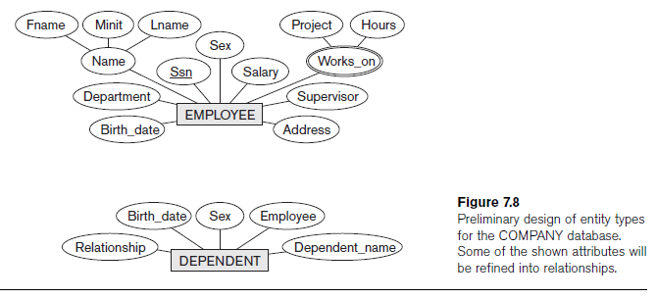
Initial Conceptual Design of the COMPANY Database

Slide 16
Relationship Types, Relationship Sets, Roles, and Structural Constraints
Relationship
  When an attribute of one entity type refers to another entity type
  Represent references as relationships not attributes

Slide 17
Relationship Types, Sets, and Instances
Relationship type R among n entity types E₁, E₂, ..., E_{n}
  Defines a set of associations among entities from these entity types
Relationship instances r_{i}
  Each r_{i} associates n individual entities (e₁, e₂, ..., e_{n})
  Each entity e_{j} in r_{i} is a member of entity set E_{j}

Slide 18
Relationship Degree
Degree of a relationship type
  Number of participating entity types
  Binary, ternary
Relationships as attributes
  Think of a binary relationship type in terms of attributes

Slide 19
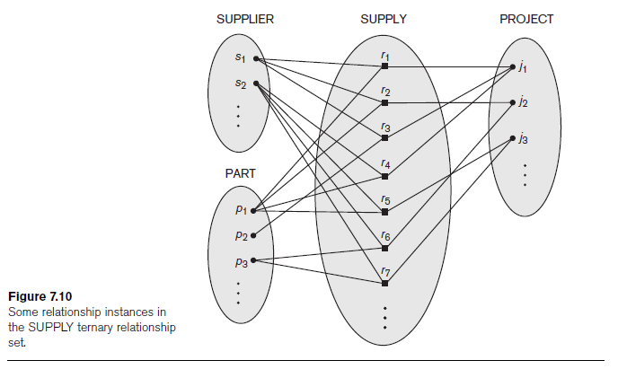

Slide 20
Role Names and Recursive Relationships
Role names and recursive relationships
  Role name signifies role that a participating entity plays in each relationship instance
Recursive relationships
  Same entity type participates more than once in a relationship type in different roles
  Must specify role name

Slide 21
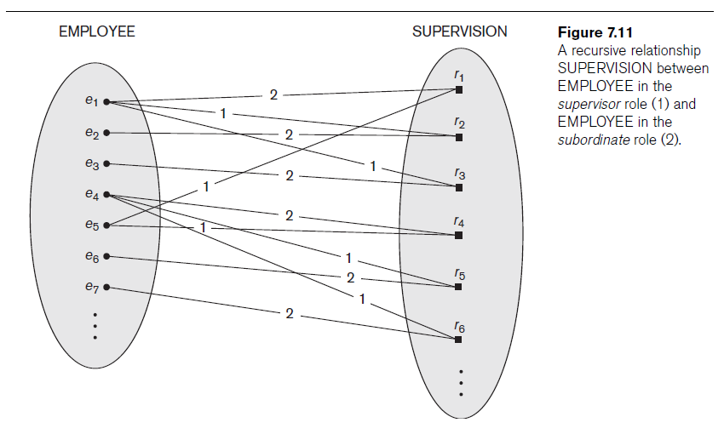

Slide 22
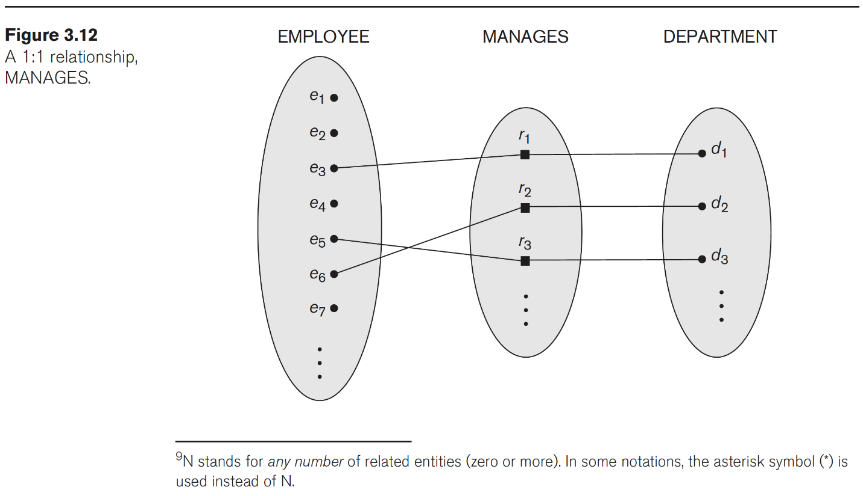
Constraints on Binary Relationship Types
Cardinality ratio for a binary relationship
  Specifies maximum number of relationship instances that entity can participate in

Slide 23
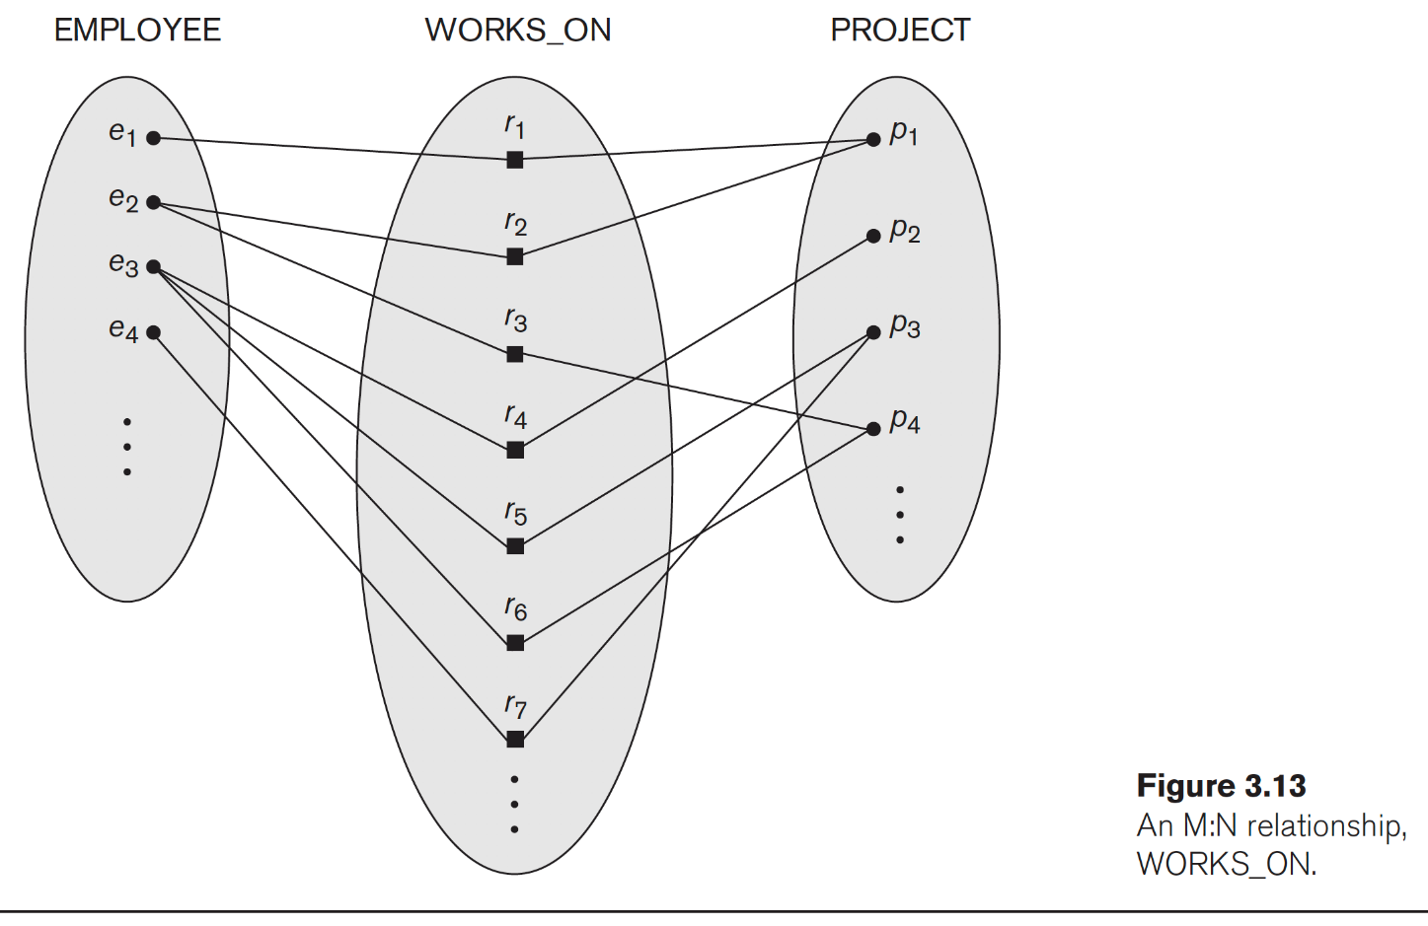
Constraints on Binary Relationship Types (Cont’d)
Cardinality ratio for a binary relationship

Slide 24
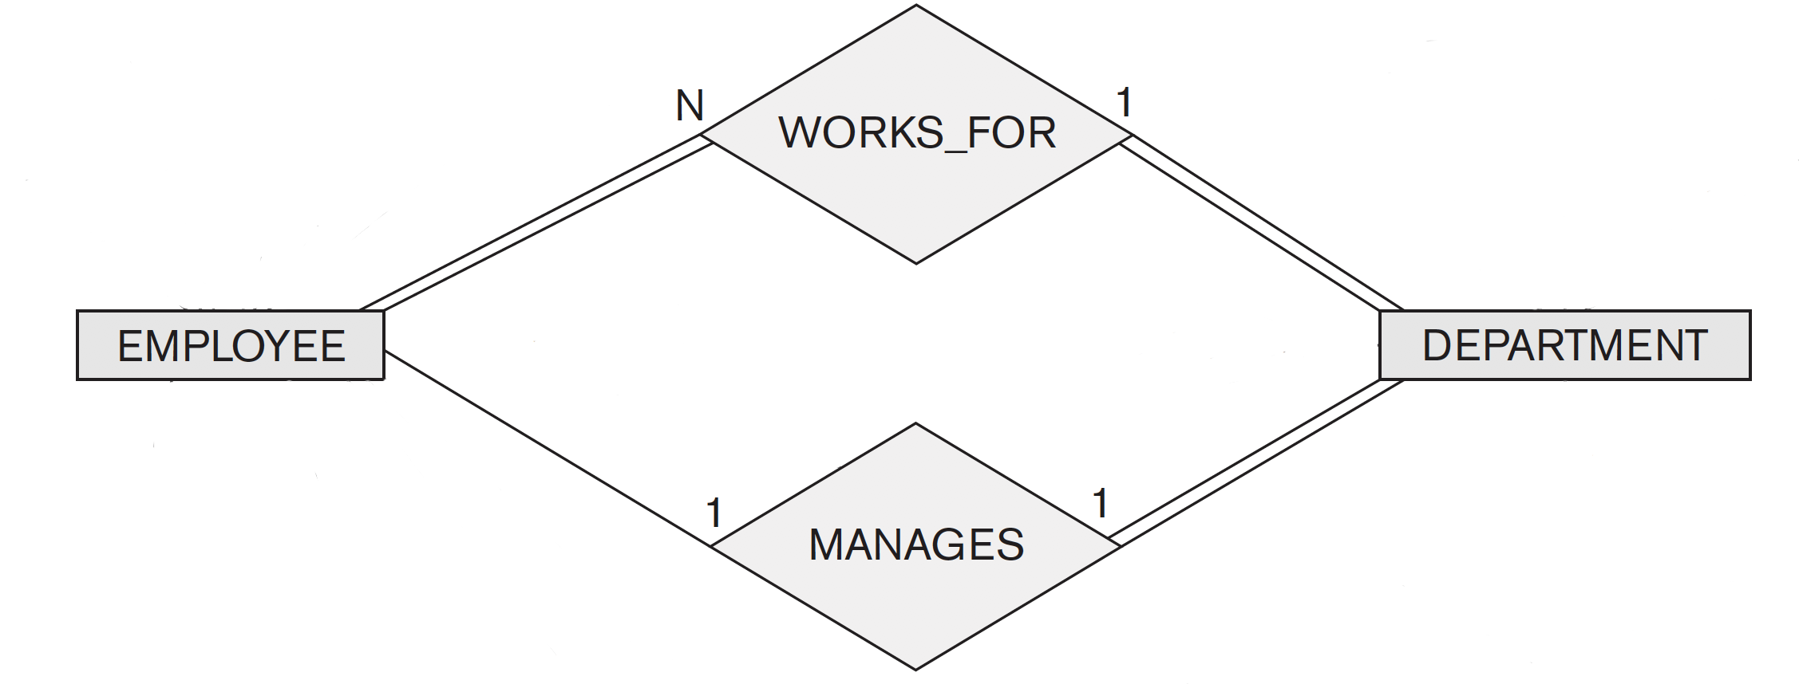
Constraints on Binary Relationship Types (Cont’d)
Participation constraint
  Specifies whether existence of entity depends on its being related to another entity
  Types: total and partial
  Total for double line and partial for single line

Slide 25
Attributes of Relationship Types
Attributes of 1:1 or 1:N relationship types can be migrated to one entity type
For a 1:N relationship type
  Relationship attribute can be migrated only to entity type on N-side of relationship
For M:N relationship types
  Some attributes may be determined by combination of participating entities
  Must be specified as relationship attributes

Slide 26
Weak Entity Types
Do not have key attributes of their own
  Identified by being related to specific entities from another entity type
Identifying relationship
  Relates a weak entity type to its owner
Always has a total participation constraint

Slide 27
Refining the ER Design for the COMPANY Database
Change attributes that represent relationships into relationship types
Determine cardinality ratio and participation constraint of each relationship type

Slide 28
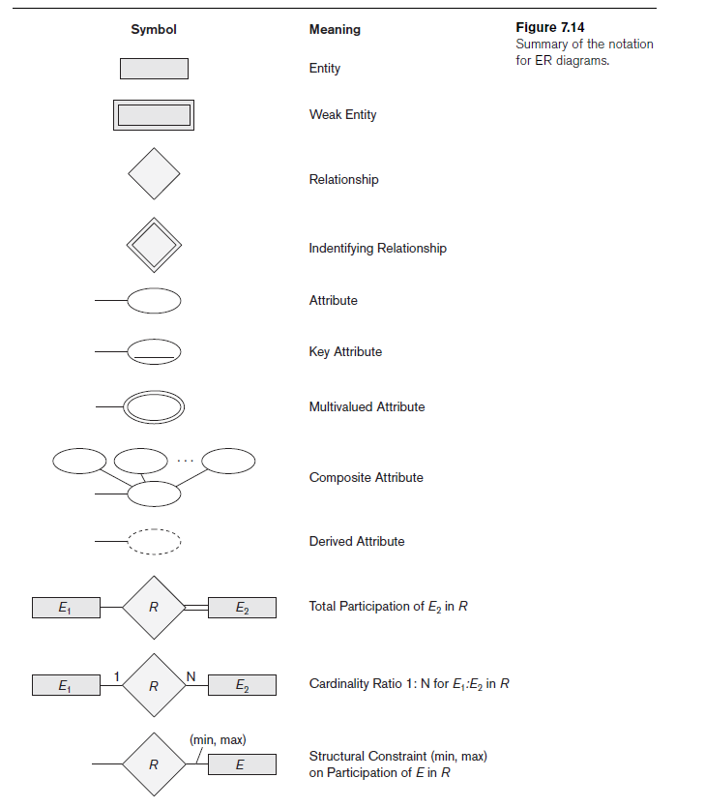
ER Diagrams, Naming Conventions, and Design Issues

Slide 29
Proper Naming of Schema Constructs
Choose names that convey meanings attached to different constructs in schema
Nouns give rise to entity type names
Verbs indicate names of relationship types
Choose binary relationship names to make ER diagram readable from left to right and from top to bottom

Slide 30
Design Choices for ER Conceptual Design
Model concept first as an attribute
  Refined into a relationship if attribute is a reference to another entity type
Attribute that exists in several entity types may be elevated to an independent entity type
  Can also be applied in the inverse

Slide 31
Alternative Notations for ER Diagrams
Specify structural constraints on relationships
  Replaces cardinality ratio (1:1, 1:N, M:N) and single/double line notation for participation constraints
  Associate a pair of integer numbers (min, max) with each participation of an entity type E in a relationship type R, where 0 ≤ min ≤ max and max ≥ 1

Slide 32
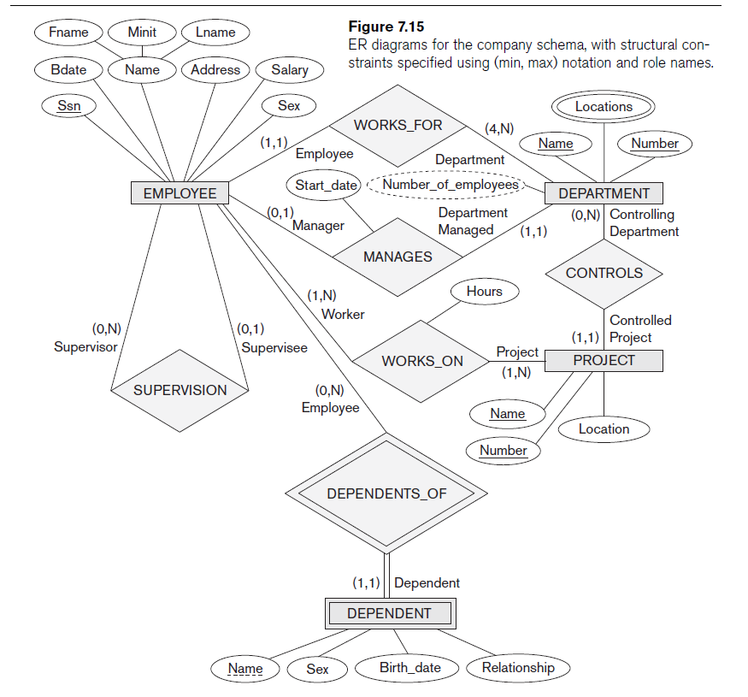

Slide 33
Example of Other Notation:
UML Class Diagrams
UML methodology
  Used extensively in software design
  Many types of diagrams for various software design purposes
UML class diagrams
  Entity in ER corresponds to an object in UML

Slide 34
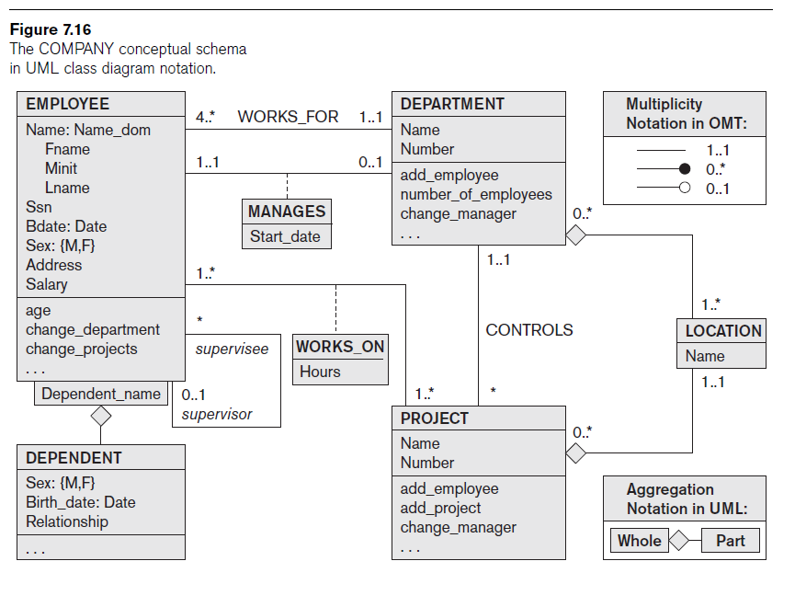

Slide 35
Example of Other Notation:
UML Class Diagrams (cont’d.)
Class includes three sections:
  Top section gives the class name
  Middle section includes the attributes;
  Last section includes operations that can be applied to individual objects

Slide 36
Example of Other Notation:
UML Class Diagrams (cont’d.)
Associations: relationship types
Relationship instances: links
Binary association
  Represented as a line connecting participating classes
  May optionally have a name
Link attribute
  Placed in a box connected to the association’s line by a dashed line

Slide 37
Example of Other Notation:
UML Class Diagrams (cont’d.)
Multiplicities: min..max, asterisk (*) indicates no maximum limit on participation
A single asterisk indicates a multiplicity of 0..*, and a single 1 indicates a multiplicity of 1..1.

Slide 38
Example of Other Notation:
UML Class Diagrams (cont’d.)
Types of relationships: association and aggregation
Distinguish between unidirectional and bidirectional associations
Model weak entities using qualified association

Slide 39
Relationship Types of Degree
Higher than Two
Degree of a relationship type
  Number of participating entity types
Binary
  Relationship type of degree two
Ternary
  Relationship type of degree three

Slide 40
Choosing between Binary and Ternary (or Higher-Degree) Relationships
Some database design tools permit only binary relationships
  Ternary relationship must be represented as a weak entity type
  No partial key and three identifying relationships
Represent ternary relationship as a regular entity type
  By introducing an artificial or surrogate key

Slide 41
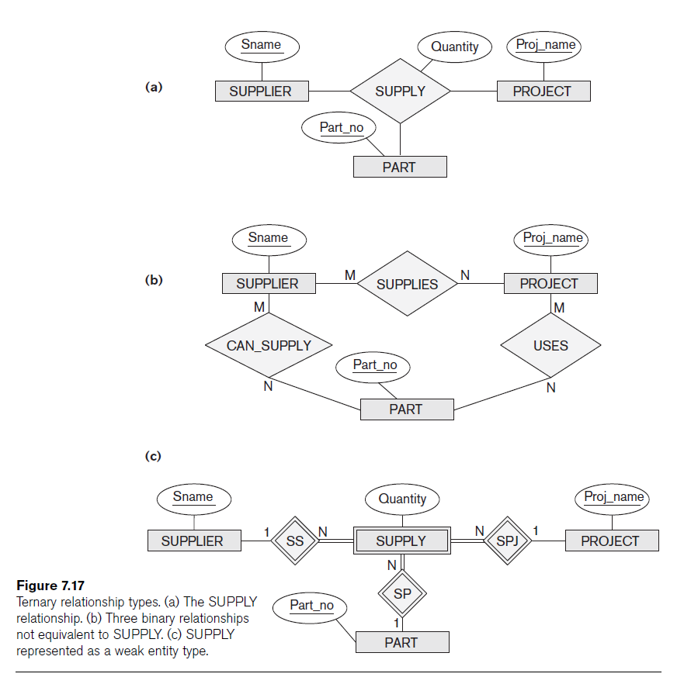

Slide 42
Constraints on Ternary (or Higher-Degree) Relationships
Notations for specifying structural constraints on n-ary relationships
  Should both be used if it is important to fully specify structural constraints

Slide 43
Summary
Basic ER model concepts of entities and their attributes
  Different types of attributes
  Structural constraints on relationships
ER diagrams represent E-R schemas
UML class diagrams relate to ER modeling concepts

